Slide 1
Yoga Posture Recognition For Self Training
Presented By
Aakash Kumar Singh Abhinav Dubey
IT/70/15 It/56/55
Supervised By
Janib-ul Bashir
National Institute Of Technology, Srinagar

Slide 2

Introduction
Motivation
Pictorial representation of the ENTIRE project
DataBase Formation
Pose estimation
Region of Interest
Libraries used
Results

Slide 3
INTRODUCTION

Slide 4
INTRODUCTION
Yoga-asana [1] : is a Sanskrit term translating to “posture” or “pose” i.e a steady , comfortable seat specifically for meditation
Problem addressed : Incorrect postures lead to physical musculoskeletal disorders including osteoarthritis , hyper kyphosis and lower back pain
Solution : We propose a computer-based solution[2] ,[3] for the above which requires NO 3rd person involvement

Slide 5
MOTIVATION

Slide 6
Motivation (What brings us here)
Solving a real life issue of damage caused via incorrect postures
Practical implementation of Machine Learning algorithms , and working with datasets
Understanding the widespread uses of classification methodology not only for this project, but as a whole
Not a plethora of research done on Human Pose Estimation topic

Slide 7
PICTORIAL REPRESENTATION OF THE PROJECT

Slide 8
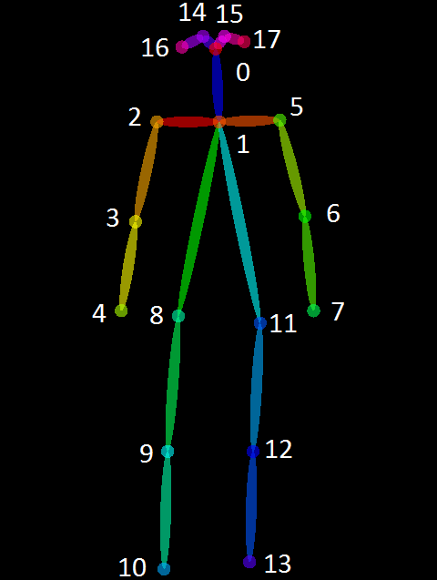
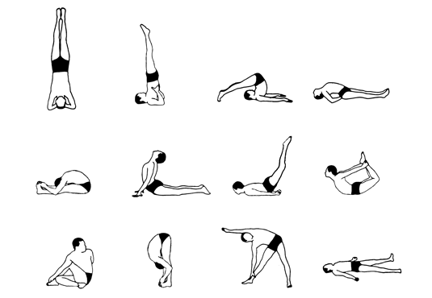
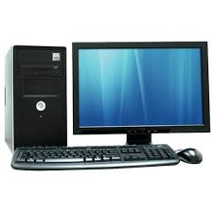
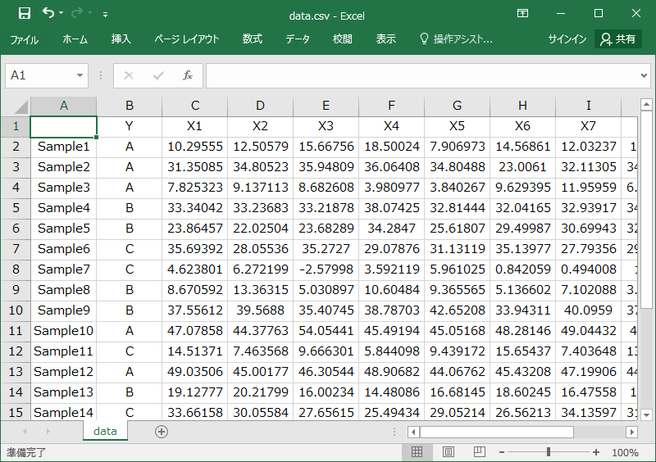



Pictorial walk-through

Slide 9
DataBase Formation

Slide 10
DataBase Formation :
web scraping
Normalization
POSENET [4] : a vision model that estimates the key body joints
Input format : jpg , png
Output fromat : JSON (when data is sent from server to webpage)
JSON to DATA FRAMES to CSV FILE

Slide 11
Pose estimation

Slide 12
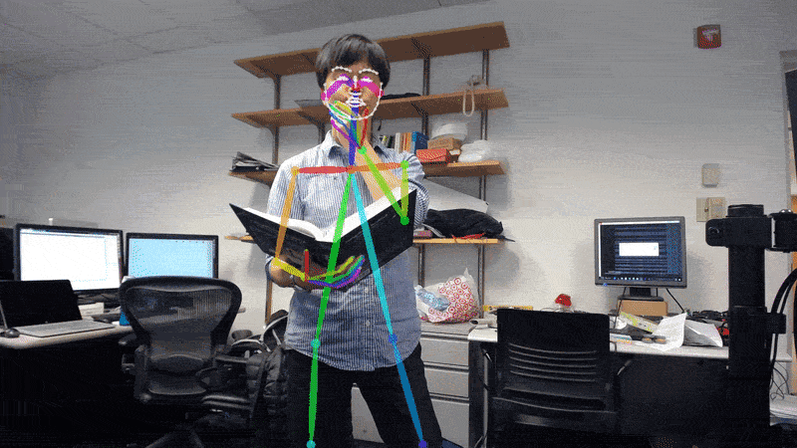
Pose Estimation :
Input image to identify (Test dataset)
Use PoseNet [4]
Read database csv file (training dataset)
Apply classification and clustering algo

Slide 13
Region Of Interest

Slide 14
ROI (Region of Interest) :
Angle calculation
Images in training dataset of each posture are used to find median of the angles (ideal angles)
Desired angles for input images are calculated (real angles)
Similarity in angles ( ideal vs. real ) ~ accuracy

Slide 15
Libraries Used

Slide 16
Libraries Used :
PoseNet [4] : JSON library , used at front end
Flask : for backend and frontend communication
NumPy [5] : for statistical computation . eg : median calculation
Google_images_download [4] : for web scaraping
Glob : for image related operations. Eg: image resize , rename
Sklearn [7] : for ML related work like classification and predication

Slide 17
Results

Slide 18
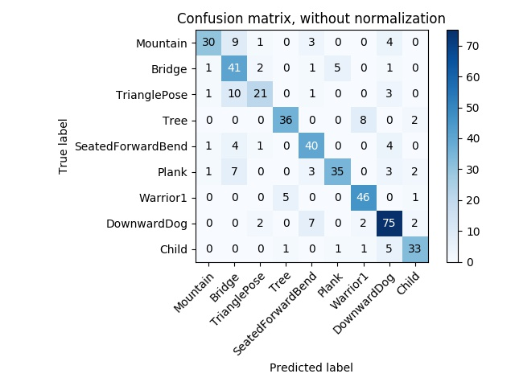
Results
Confusion Matrix For All the Poses in
Database

Slide 19
Result

Slide 20
Results

Slide 21
Results

Slide 22
References

Slide 23
References (1) :
[1] https://www.yogajournal.com/
[2] A. Toshev and C. Szegedy, “DeepPose: Human pose estimation via deep neural networks,” in
CVPR, 2014
[3] Z. Cao, T. Simon, S. Wei, and Y. Sheikh, “Realtime multi-person 2D pose estimation using
part affinity fields
[4] https://medium.com/tensorflow/real-time-human-pose-estimation-in-the-browser-with-tensorflow-js-7dd0bc881cd5 and https://github.com/tensorflow/tfjs-models/tree/master/posenet

Slide 24
References (2) :
[5] https://docs.scipy.org/doc/numpy/user/whatisnumpy.html
[6] https://pypi.org/project/google_images_download/
[7] https://scikit-learn.org/stable/modules/generated/sklearn.model_selection

Slide 25
THANK YOU !!
Q&A

